Slide 1


Lost and Found Portal
A Simple CRUD Web Application
A clean, efficient web application for managing lost and found items with a modern tech stack.
Notes:
1

Slide 2

Introduction & Technology Stack
Project Overview
Modern, Lightweight Stack
This Lost and Found Portal is a simple yet powerful web application designed to help users report found items and claim them through a central system. It provides an intuitive interface for managing items with full CRUD functionality—Create, Read, Update, and Delete operations.
Backend: Python—clean, readable, and powerful
Framework: Flask—a micro-framework requiring minimal code
Database: SQLite—serverless, file-based, zero setup
Frontend: HTML & CSS—standard, responsive building blocks
The application solves a real problem: creating an organized, searchable repository where community members can post discoveries and reconnect lost belongings with their owners.
Notes:
2

Slide 3
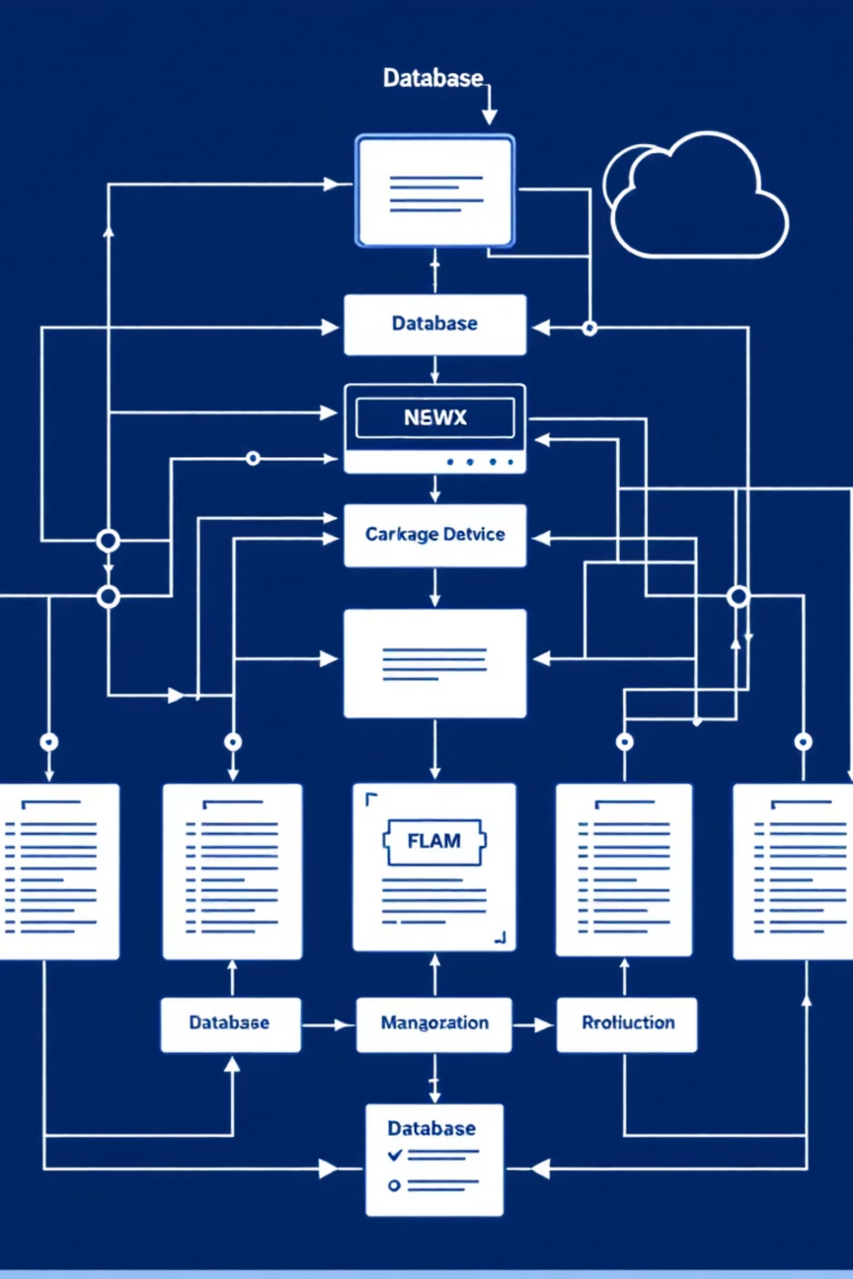



System Architecture & Data Flow
The system is structured in two levels of data flow diagrams to show both the holistic view and internal processes.
User Input
New items and management actions
System Process
Add, display, and manage items
Output
Updated item list and confirmations
Core System Processes
Add Item
Display Items
Captures user data and writes to database
Reads database to show item list
Manage Item
Updates or deletes items based on actions
Notes:
3

Slide 4
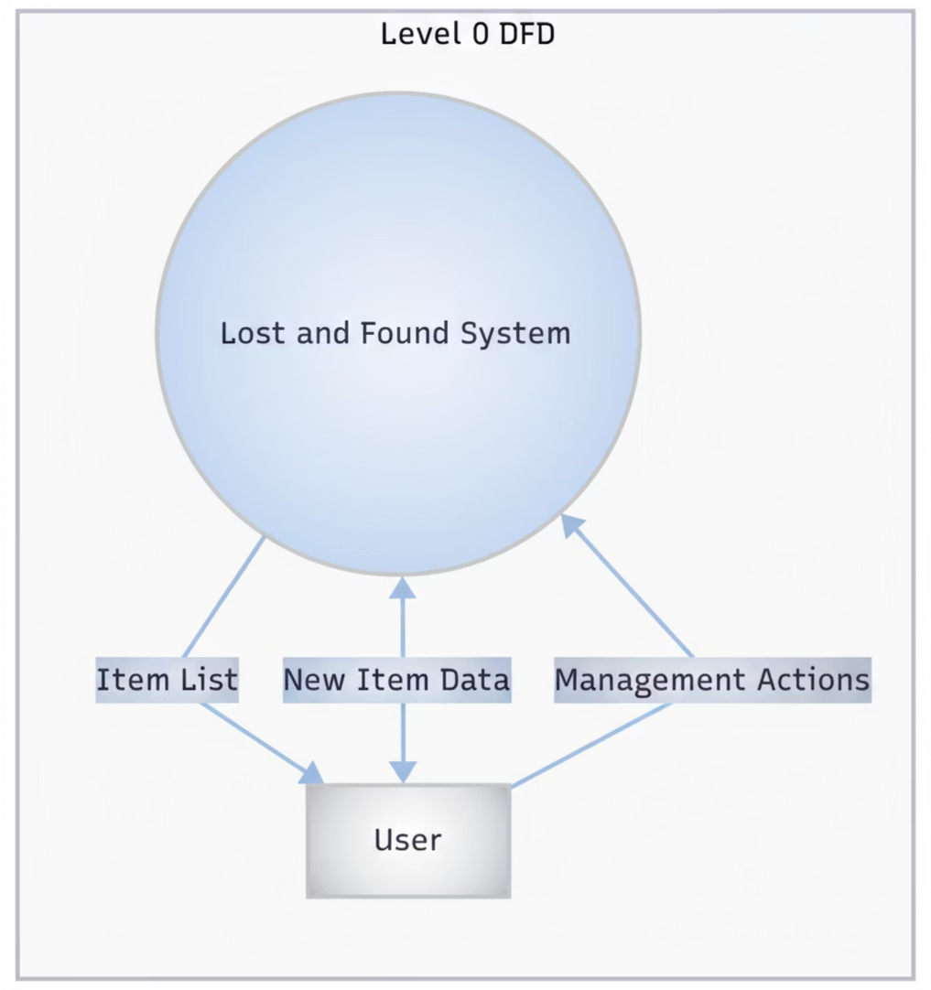
System Design (DFD Level 0)
Notes:
4

Slide 5
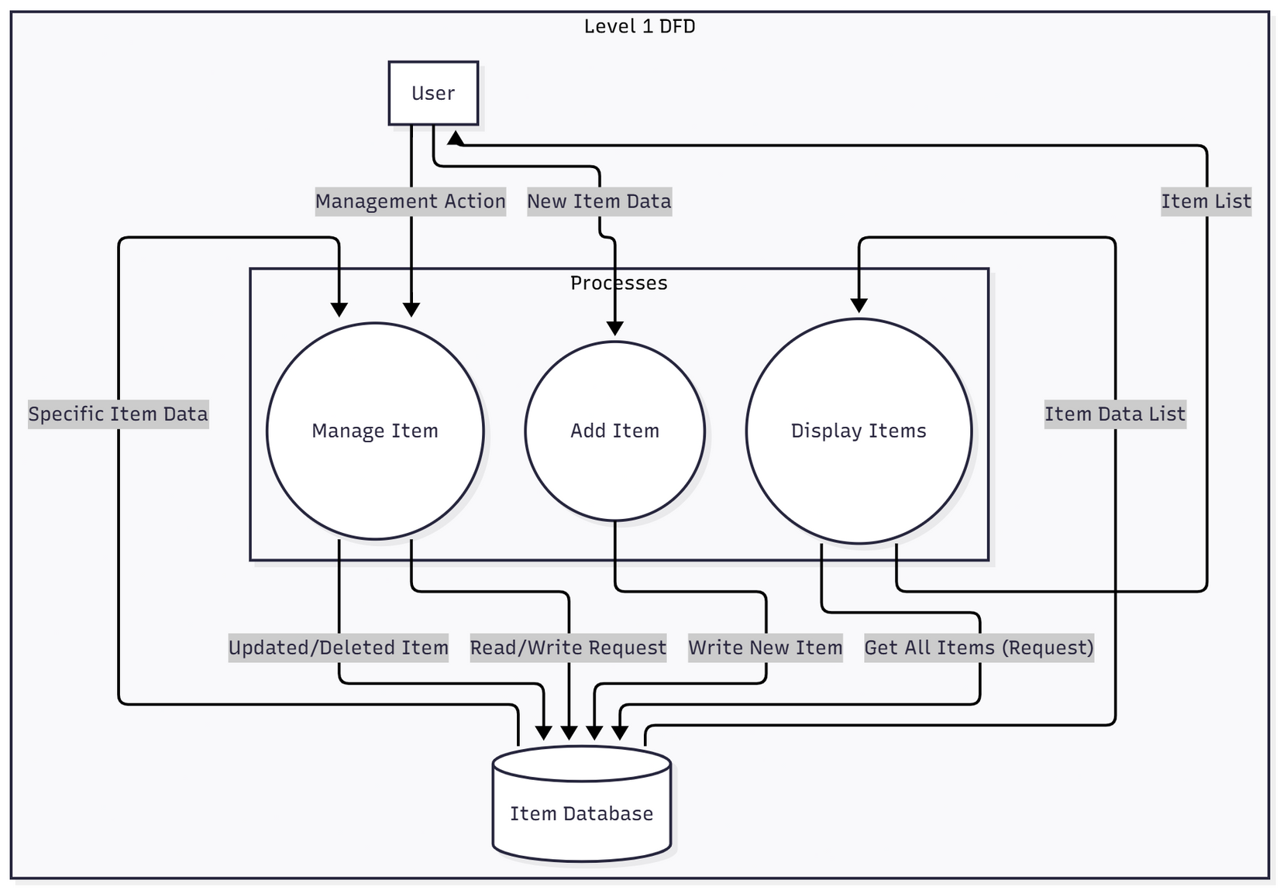
System Design (DFD Level 1)
Notes:
5

Slide 6
Database Design
A streamlined single-table model optimized for efficiency and simplicity, following Third Normal Form (3NF) principles.
Item Table Structure
Field
Type
Constraint
Purpose
id
Integer
Primary Key
Unique identifier for each item
name
String
Required
Item name (e.g., "Blue Wallet")
description
String
Optional
Detailed item information
location
String
Required
Where the item was found
date_found
Date
Required
When the item was discovered
status
String
Required
Unclaimed or Claimed status
This 3NF structure eliminates data redundancy and ensures data integrity—all fields depend directly on the primary key with no repeating groups.
Notes:
6

Slide 7
CRUD Operations in Action
Create
1
Users submit the "Add Item" form with item details, which are validated and written to the database instantly.
Read
2
All items are displayed in a clean, searchable table on the homepage for users to browse and identify their belongings.
Update
3
Item details can be edited, and status can be changed from "Unclaimed" to "Claimed" when an owner is found.
Delete
4
Administrators can permanently remove items from the database when they are no longer needed or are incorrectly entered.
Notes:
7

Slide 8

User Interface & Experience
The application prioritizes simplicity and intuitiveness, allowing users to manage items in just a few clicks.
Pages & Components
Visual Design
Home Page: Clean table view of all items with sorting and filtering
A consistent, modern stylesheet (style.css) creates a professional appearance throughout the application. The interface uses intuitive navigation, clear typography, and organized layout to reduce friction and help users accomplish their goals quickly.
Add Item Form: Single reusable form for creating and editing items
Action Buttons: Quick access to edit, claim, and delete operations
Responsive Design: Works seamlessly on desktop and mobile devices
Notes:
8

Slide 9

Project Summary & Next Steps
✓ Complete
⚡ Efficient
🚀 Scalable
Full-stack Lost and Found application with all CRUD operations implemented and tested
Simple Flask and SQLite stack proven to be fast, reliable, and easy to maintain
Solid foundation ready for expansion with user accounts, notifications, and advanced search
The Lost and Found Portal is fully functional, meets all requirements, and serves as an excellent foundation for future enhancements.
Notes:
9

Slide 10
Thank You!
I appreciate your time and attention today. We hope this presentation provided a clear understanding of the Lost and Found Portal's design and functionality.

